Slide 1
The Scatter
The Scatter

Slide 2
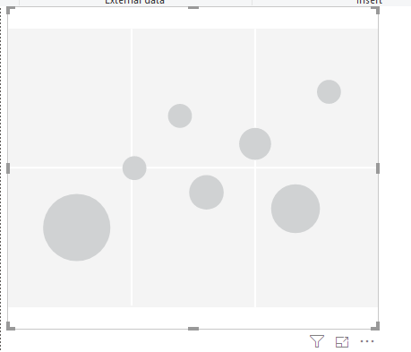
The Scatter
Note: This workshop is using Sales.xlsx of Excel Sources
Add a Scatter to the scène

Slide 3
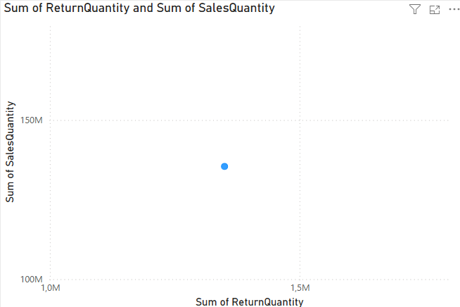
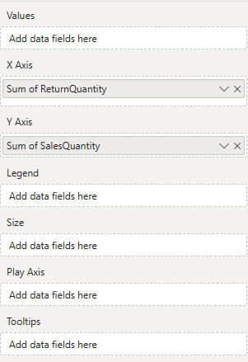

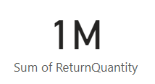
The Scatter
Add ReturnQuantity and SalesQuantity from FactSales respectively to the X-Axis and Y-Axis

Slide 4

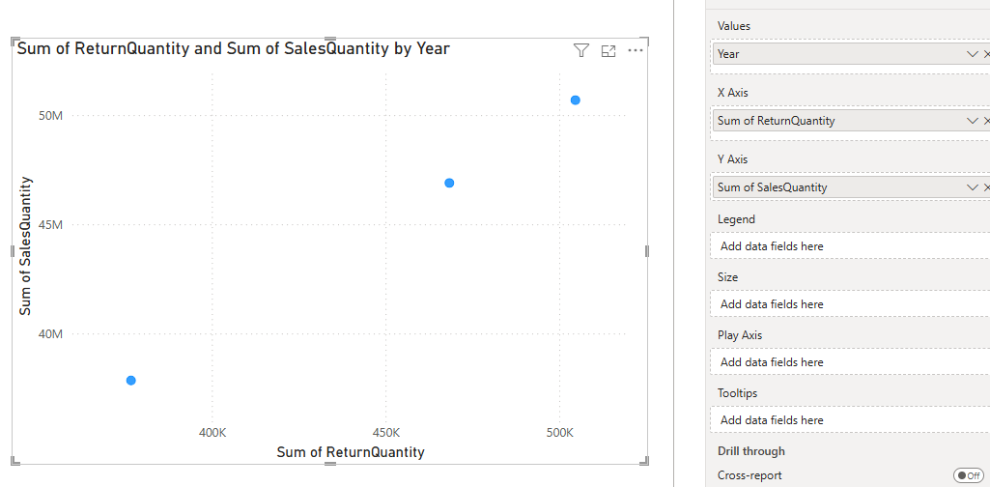


The Scatter
Then add Year form DimDate to the Values

Slide 5
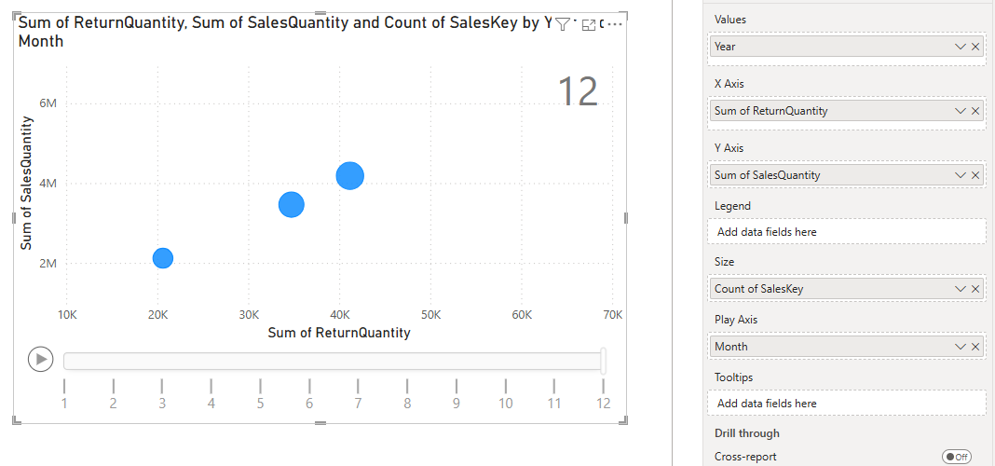
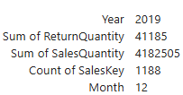
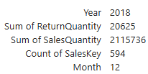
The Scatter
Then add SalesKey to the Size

Slide 6
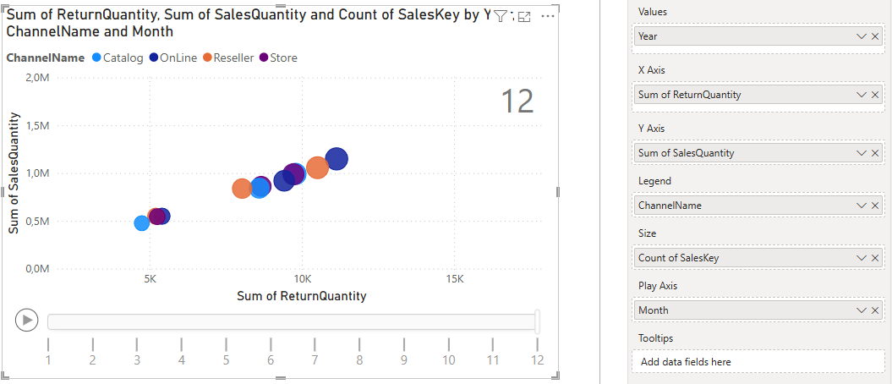
The Scatter
Then add Channel Name to the Legend and observe

Slide 7
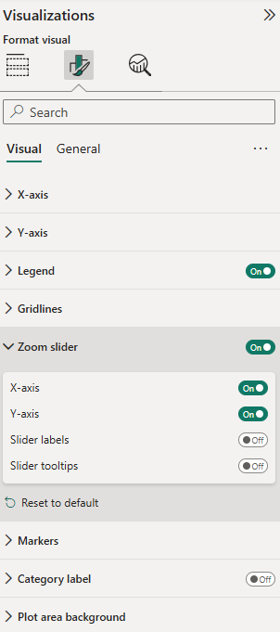
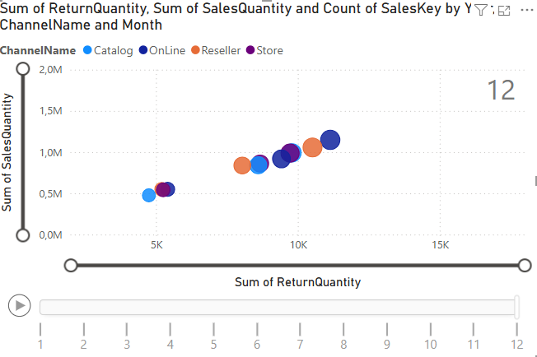
The Scatter
Activate the Zoom slider from the format tab

Slide 8
Thank you
Thank you

